Slide 1
IOT BASED AIR POLLUTION MONITORING DEVICES

Slide 2
Introduction
Air pollution is probably one of the most serious environmental problems confronting our civilization today.
We offer a simple solution to monitor the amount of pollution with the help of IOT and a simple monitoring system consisting of simple components.

Slide 3
Components required
Bread board
microcontroller
Gas sensor(MQ135)
WIFI module(ESP8266)
Buzzer

Slide 4
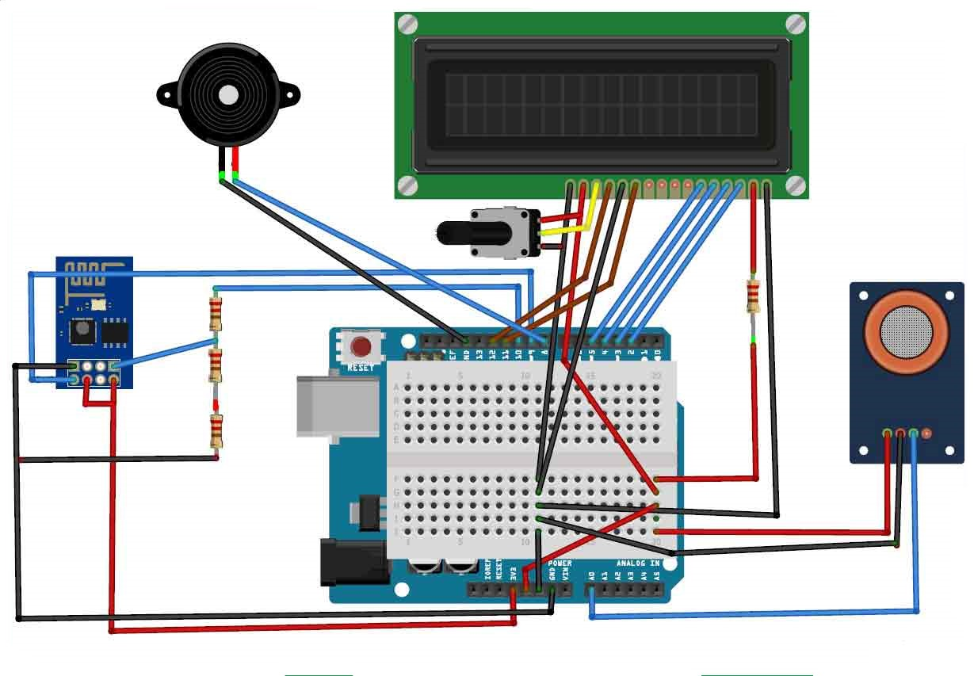
Circuit diagram :

Slide 5
INTERNET OF THINGS
IOT is a system of interrelated computing devices, mechanical and digital system unique identifiers and the ability t transfer data over a network without requiring human to human or human to computer interaction

Slide 6
Arduino
In this project the central control system is the Arduino UNO which is a microcontroller board based on the ATmega328P
It has 14 digital input/output pins (of which 6 can be used as PWM outputs),
6 analog inputs,
a 16 MHz quartz crystal,
a USB connection,
a power jack,
an ICSP header and
a reset button

Slide 7
WIFI module (ESP8266)
It is microchip with full TCP/IP stack and microcontroller capability .
Using for its safety and easiness as it’s delicate module to use
It is 3v wife module very popular for its IOT application

Slide 8
GAS SENSOR (MQ135)
It is used for air quality by setting a threshold value using the potentiometer
It can detect NH3, Nox, alchol, benzene, sulphur, co2,etc…

Slide 9
Air quality
The safe level of air quality is 350 PPM
When it exceeds the limit of 1000 PPM, then it starts cause Headaches, sleepiness and stagnant, stale, stuffy air
if exceeds beyond 2000 PPM then it can cause increased heart rate and many other diseases.

Slide 10
Working
The gas sensor measures the air quality and sends the information to the controller.
The controller then uploads the data to the local server that has been set up via the WIFI module.
The LCD serves as a way for reading the recorded data from the site of installation.
Many such devices can be placed around the district and made to upload the recorded data to the network.

Slide 11
By placing these monitors in several areas we can monitor the quality of air in all the installed places.
Since the threshold value is changeable the range of the device is varied for optimal output.
The recorded data is more than enough to prove that the area is polluted or not.
By making the data available to all we offer the chance to construct a eco-friendly environment

Slide 12
Thank you
Submitted By
Prabu.s
Mohammed sattar.B
Jayapreetha Rajasekar

